Slide 1
Phytophthora infestans
“The plant destroyer”
https://doi.org/10.1094/PHYTO-01-11-0025

Slide 2
Phytophthora videos
P. capsici on cucumber:
https://www.youtube.com/watch?v=RB2K7H8qKgA&ab_channel=HuitemaLab

Slide 3
Taxonomy, phylogeny, etc.

Slide 4
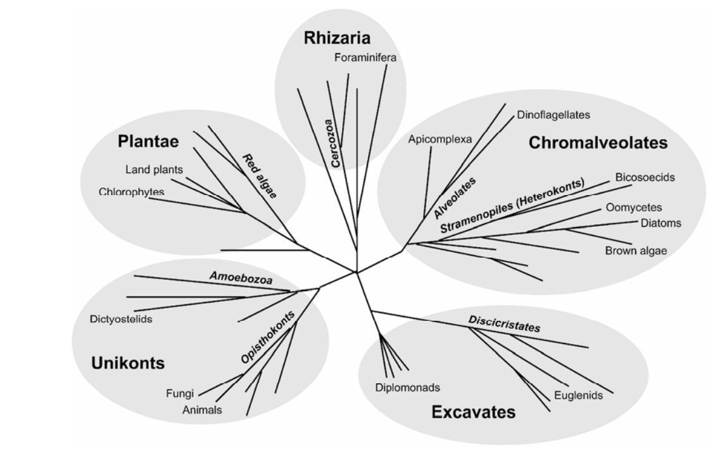
Phytophthora’s Evolutionary neighborhood
Notes:
I always like to know the evolutionary neighborhood of microbes. Ralstonia is a gram-negative beta-proteobacteria rod. It’s a cousin to Burkholderia which is becoming an emerging infectious disease of humans.

Slide 5
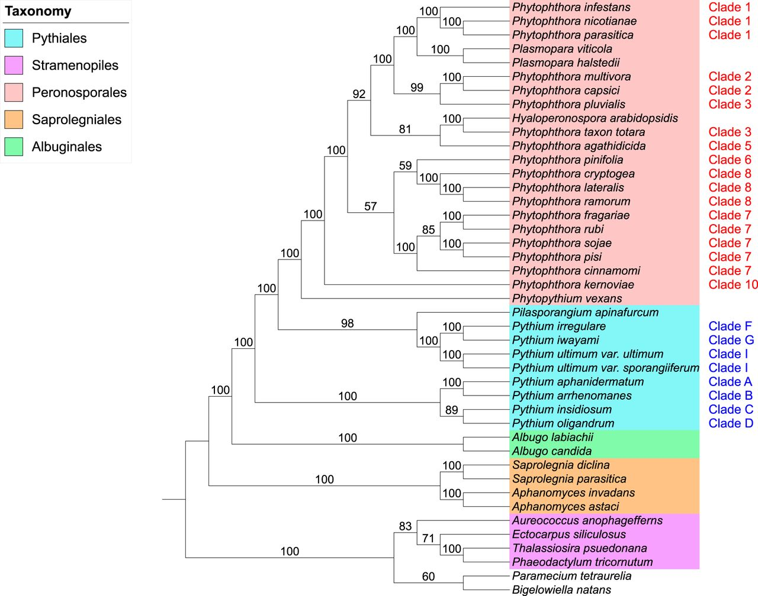
https://journals.asm.org/doi/10.1128/mSphere.00095-17#B10

Slide 6
Biology of Oomycetes vs. Fungi

Slide 7
Phytophthora videos
Sporangium releasing oospores:
https://www.youtube.com/watch?v=t4iUZidJd9c&ab_channel=TheTrainingTree

Slide 8
Oomycetes
Fungi
Cell wall chemistry
Hyphal structure
Asexual spores
Sexual Spores
oomycetes
fungi

Slide 9
Oomycetes
Fungi
Energy storage carbohydrate
Secondary metabolites
Pigmentation
oomycetes
fungi

Slide 10
Oomycetes
Fungi
Gene structure
Promoters/
transcription
oomycetes
fungi

Slide 11
Bats are not birds.
Dolphins are not fish. ….
Kamoun lab
@TheSainsburyLaboratory

Slide 12
Prof. Lowe-Power discusses the Irish Potato famine

Slide 13
Disease Biology

Slide 14
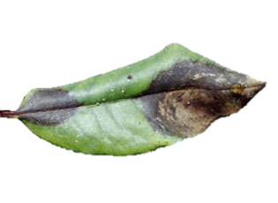
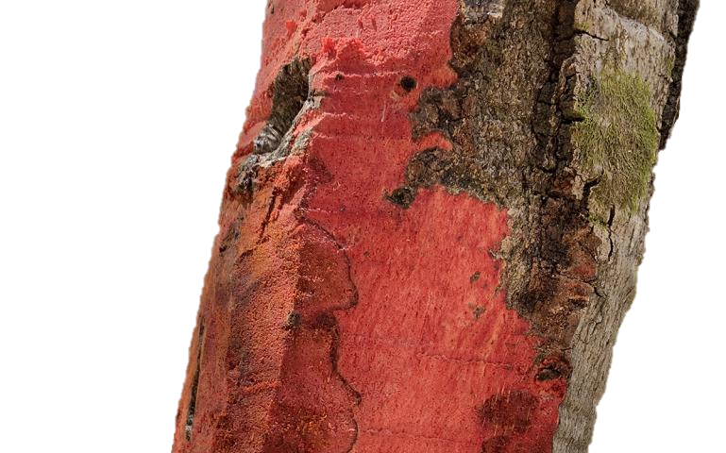
Phytophthora sp.: Important Diseases
https://www.latimes.com/science/sciencenow/la-sci-sn-sudden-oak-death-unstoppable-20160430-story.html

Slide 15
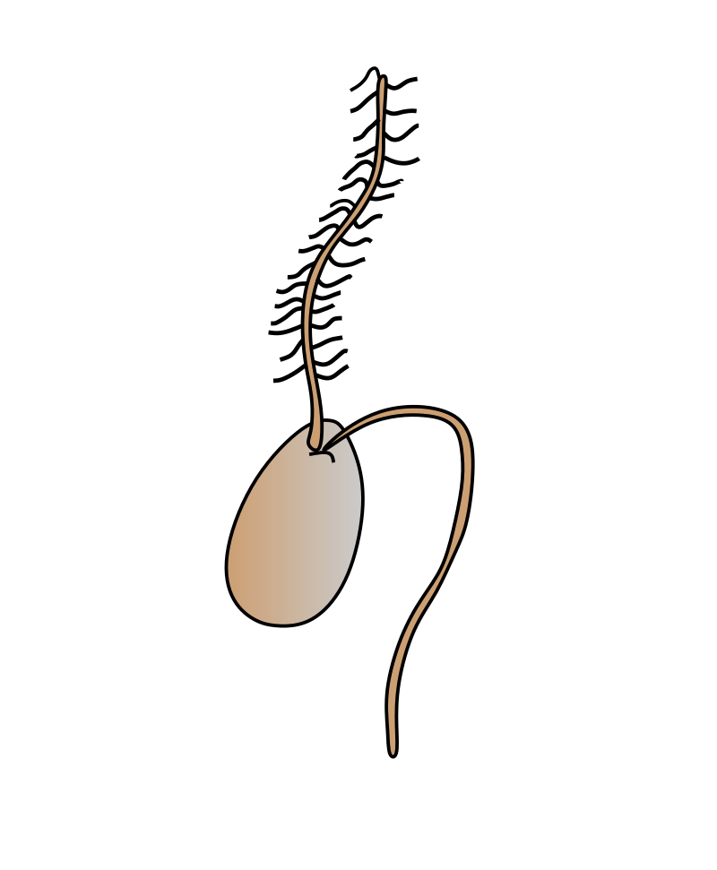
Phytophthora sp.: Germination
https://nph.onlinelibrary.wiley.com/doi/full/10.1111/nph.16650

Slide 16
Phytophthora sp.: Infection process
Zoospore
Cyst
https://nph.onlinelibrary.wiley.com/doi/full/10.1111/nph.16650

Slide 17
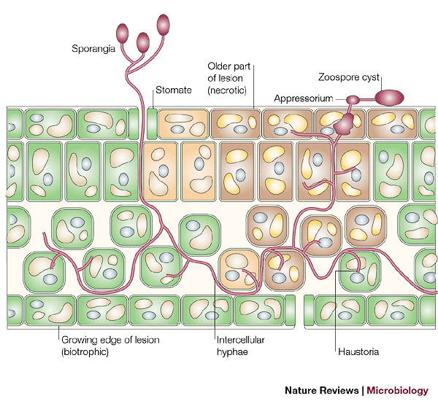
Phytophthora sp.: Symptom formation
https://www.nature.com/articles/nrmicro1064/figures/1

Slide 18
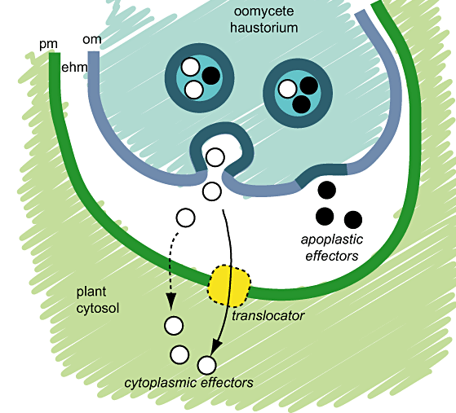
P. infestans - Molecular interactions with plants

Slide 19
P. infestans - Molecular interactions with plants
small RNAs

Slide 20
P. infestans - Molecular interactions with plants – RNA interference

Slide 21
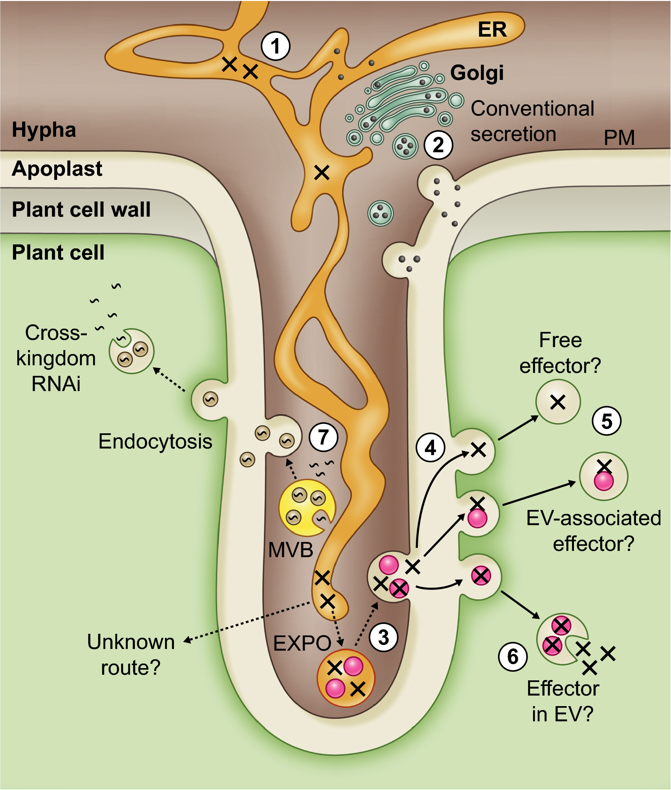
P. infestans - Molecular interactions with plants
Protein effectors
Small RNA effectors

Slide 22
Genomics

Slide 23
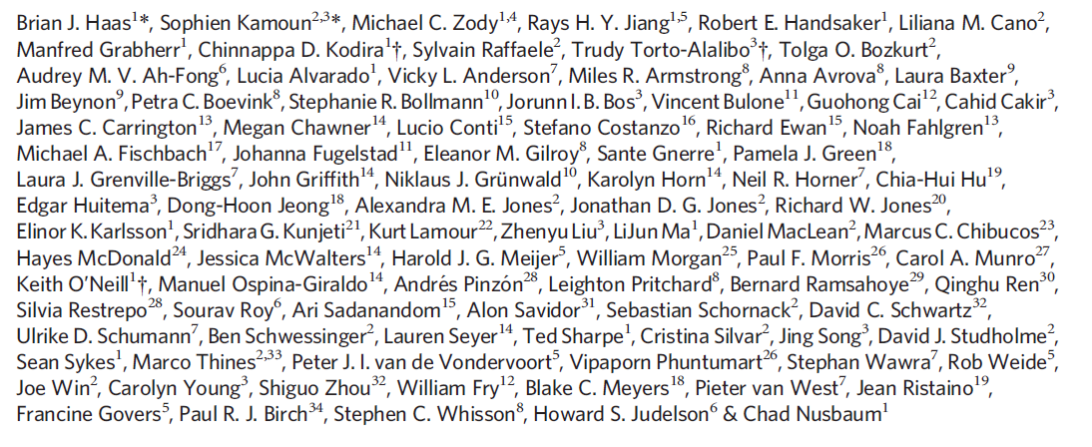
Please read the paper’s title.
Is any jargon unclear?
What will we learn about from this paper?

Slide 24
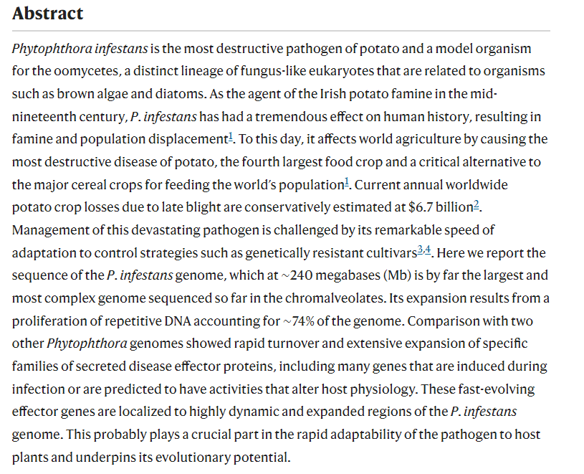
Please read the Abstract.
Is any jargon unclear?
What will we learn about from this paper?

Slide 25
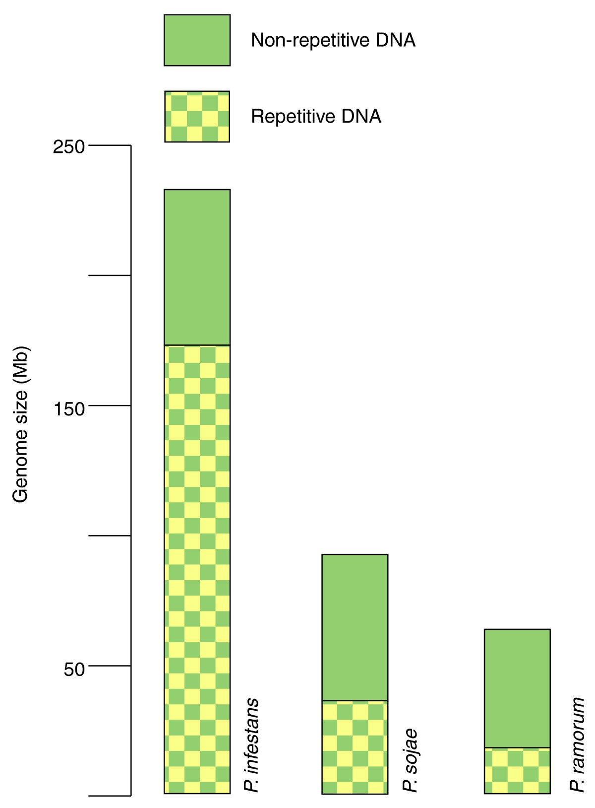
https://genomebiology.biomedcentral.com/articles/10.1186/gb-2009-10-10-241

Slide 26
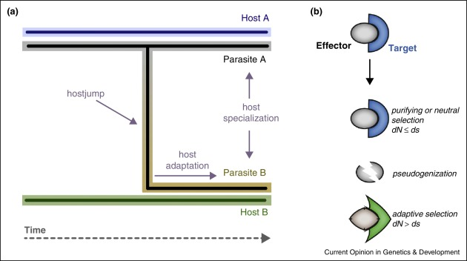
https://www.sciencedirect.com/science/article/pii/S0959437X15000945?via%3Dihub

Slide 27
How protein evolution (mutations + selection) can lead to host jumps
Effectors manipulate targets in plant cells. Variation in effector sequence in a population can provide insight into the selective pressures that act on the effector.
Population
evolution
dN: nonsynonymous substitution rates →(new amino acids)
dS: synonymous substitution rates
→ (Same amino acid/different codons)
dN
dS
Normalizes mutations that could yield new functions by the background mutation rate
Pseudogenes: genes with early stop codons.
The gene version of vestigial organs like the appendix.
Plant populations can evolve to recognize effectors & initiate immunity. Therefore the effector is a liability, host immunity selects for loss of the effector.
https://www.sciencedirect.com/science/article/pii/S0959437X15000945?via%3Dihub

Slide 29
Phytophthora videos
There are so many cool phytophthora videos on youtube! P. capsici on tomato: https://www.youtube.com/watch?v=HzVPaSh79Do&ab_channel=HuitemaLab
P. nicotianae on tobacco seedling https://www.youtube.com/watch?v=gYFVfeq_qCw&ab_channel=PlantPathology

Slide 30
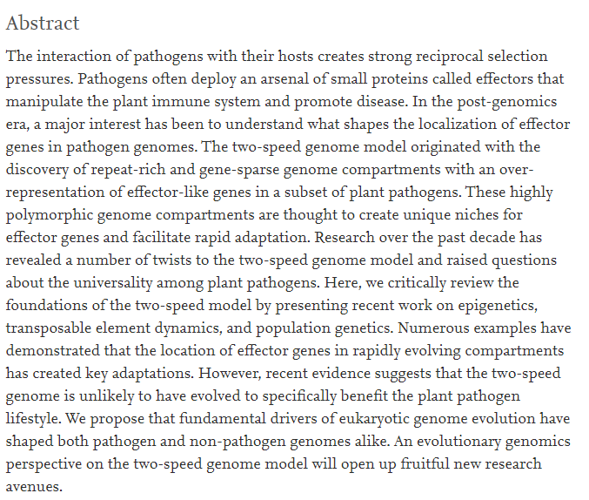

Slide 31
“Fifi the Zoospore” (P. infestans song based on “Frosty the Snowman)
https://www.youtube.com/watch?v=l9ikfDWZaT8&ab_channel=KamounLab

Slide 32
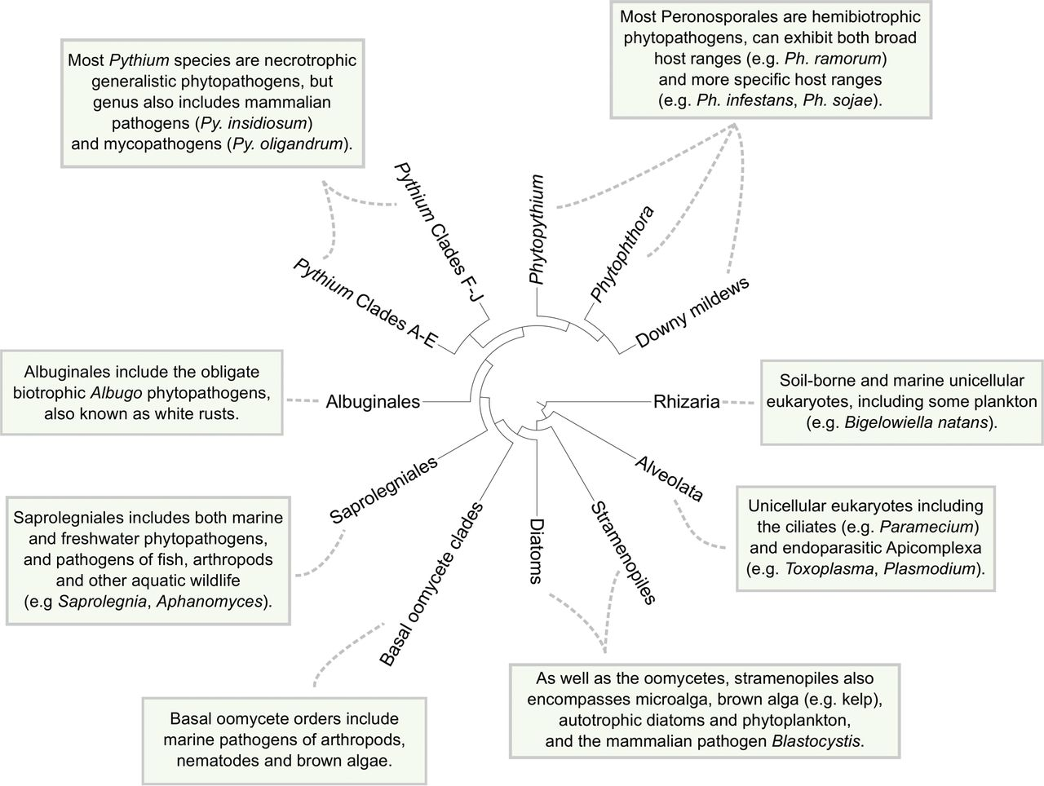
https://journals.asm.org/doi/10.1128/mSphere.00095-17#B10

